Slide 1
Dining Philosophers
A “Classical” Synchronization Problem devised by Edsger Dijkstra in 1965 (modified for the masses by Tony Hoare)
You have
  5 philosophers sitting around a table
  Spaghetti on the table
  5 forks around the table
  Each philosopher needs 2 forks to eat
Slides by Eric Wohlstadter

Slide 2
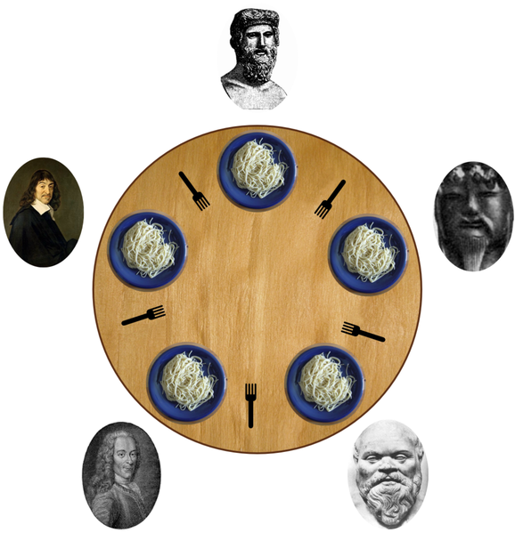

Slide 3
Dining philosophers (cont)
Each philosopher goes in a cycle
  Think for a while
  Get 2 chopsticks
  Eat for a while
  Put down the chopsticks
  Repeat
  Your task is to devise a scheme for the “Get 2 chopsticks” step

Slide 4
Solution 1 (Bad Solution)
Think();
Pick up left chopstick;
Pick up right chopstick;
Eat();
Put down right chopstick;
Put down left chopstick;
Problem: Deadlock
Why?
1. Each philosopher can pick up left fork before anyone picks up their right fork.
2. Now everyone is waiting for right fork.

Slide 5
Solution 2: Global lock
Think();
table.lock();
while(!both chopstick available)
chopstickPutDown.await();
Pick up left chopstick;
Pick up right chopstick;
table.unlock();
Eat();
Put down right chopstick;
Put down left chopstick;
chopstickPutDown.signal();

Slide 6
Solution 3: Reactive
Think();
Pick up left chopstick;
if(right chopstick available) {
Pick up right chopstick;
} else {
Put down left chopstick;
continue; //Go back to Thinking
}
Eat();

Slide 7
Solution 4: Global ordering
Think();
Pick up “smaller” chopstick from left and right;
Pick up “bigger” chopstick from left and right;
Eat();
Put down “bigger” chopstick from left and right;
Put down “smaller” chopstick from left and right;
Why can’t we deadlock?
1. It is not possible for all philosophers to have a chopstick
2. Two philosophers, A and B, must share a chopstick, X, that is “smaller” than all other chopsticks
3. One of them, A, has to pick it up X first
4. B can’t pick up X at this point
5. B can’t pick up the bigger one until X is picked up
6. SO, 4 philosophers left, 5 chopsticks total
One philosopher must be able to have two chopsticks!

